Slide 1

Data analysis on Seattle traffic collisions from 2004 to 2020
Chan Ching Kwan
14 Sep, 2020

Slide 2
Traffic collisions as society loss
Starting from 2004 to May 2020, total collisions in Seattle: 194673 cases
which means more than 32 collisions per day
Collisions
Losing life (Human capital loss)
Damage on property (Economic loss)
Traffic jam (Society time loss)
Citizen felt insecure (lost in quality of life)
Loses covered by individual or mainly insurance company and government
Conclusion: Need to reduce traffic collisions effectively

Slide 3
Objectives
Investigation the property of different collisions
1. Trend
2. Types
3. Causes
4. Correlation
Build predict model for future development
Suggestion to reduce collisions

Slide 4
Data
Data from Seattle Police Department, recorded from 01-01-2004 to 30-05-2020
Total 194673 rows with 38 types of information
Meta data file can be found:
https://s3.us.cloud-object-storage.appdomain.cloud/cf-courses-data/CognitiveClass/DP0701EN/version-2/Metadata.pdf

Slide 5
Data Removal
Rows with empty data
184146 rows remain
Repeated or unexplained information
After removal: the size of data
184146 rows x 17 columns

Slide 6
Data preprocessing
Changing string data into numeric data
1
For easier data analysis
Include weather, road condition or other bi-category data
Grouping small data into other category
2

Slide 7
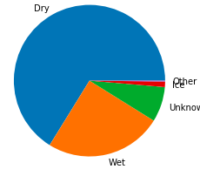
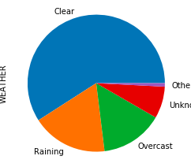
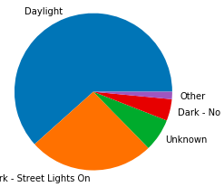
Visualization
Summary :
Most of the collisions happened
in Normal conditions
Figure 2: Pie chart for road
distribution
Figure 1: Pie chart for weather
distribution
Figure 1: Pie chart for light
distribution

Slide 8
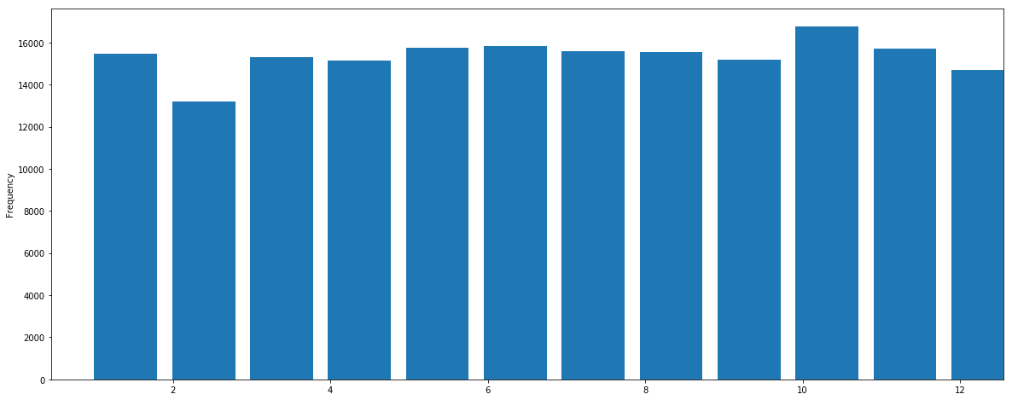
Monthly distribution visualization
Figure 4: monthly distribution of collisions.
The distribution is very even which means the seasonal effect is weak on collisions.

Slide 9
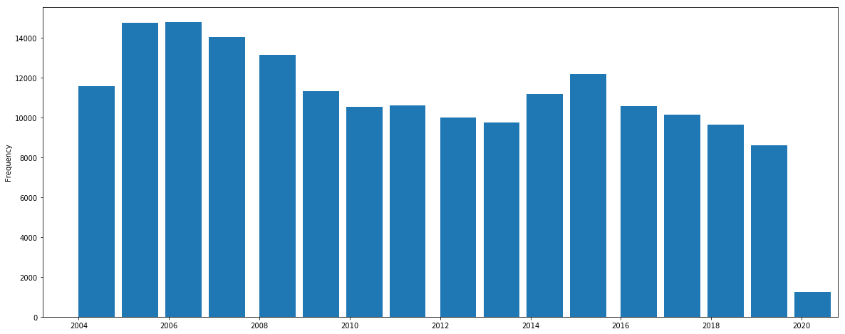
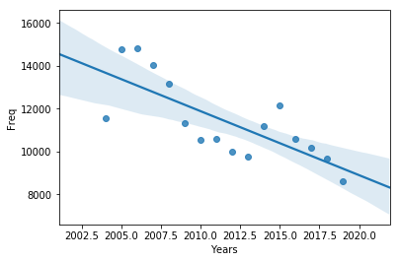
Year trend
Figure 6: The linear regression result of year distribution.
The blue linear show the regression line and the shaped area represent 68.3% confident zone. The number of collisions are decaying. The R^2 coefficient is 0.568.
Figure 5: The histogram of yearly distribution.
As shown as above, the number of 2020 is exceptionally
small because of the incomplete record. Therefore it is remove from further analysis

Slide 10
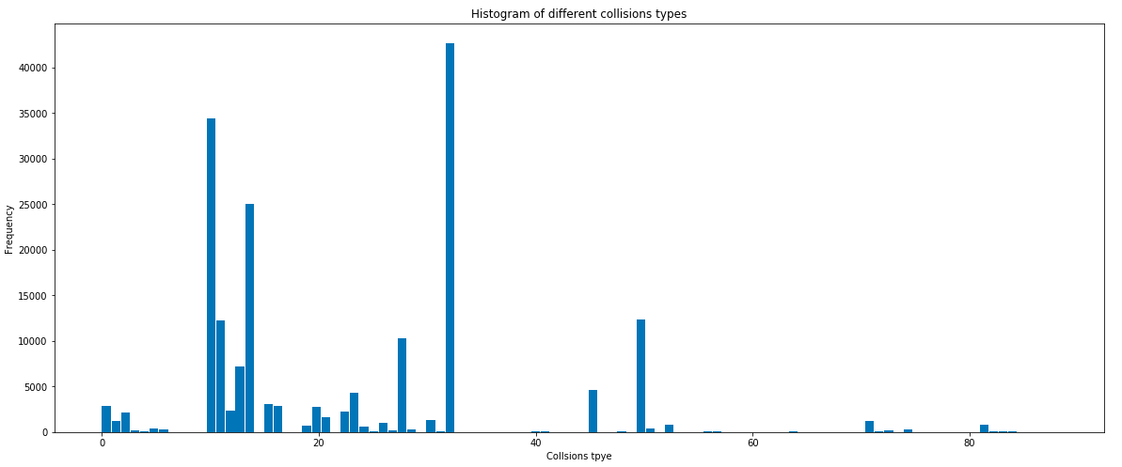
Type of collisions
The top 5 types of collisions:
32: One Parked - One Moving(23.2%)
10: Entering At Angle(18.6%)
14: From Same Direction - Both Going Straight - One Stopped - Rear End (13.6%)
50: Struck Fixed Object(6.7%)
11: From Same Direction -Both Going Straight-Both Moving- Sideswipe(5.6%)
Figure 7: The histogram of the type of collisions
The top 3 types of collisions dominate over 50% of total number.
Summary: Collisions are dominated by only 3 types, with over 50%

Slide 11
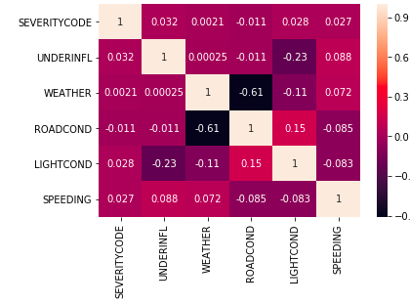
Correlation matrix
Figure 8: The heat map is the correlation matrix of different factors. The first row is seriousness against other factors but none of them show high correlation value, which means they are not main factors

Slide 12
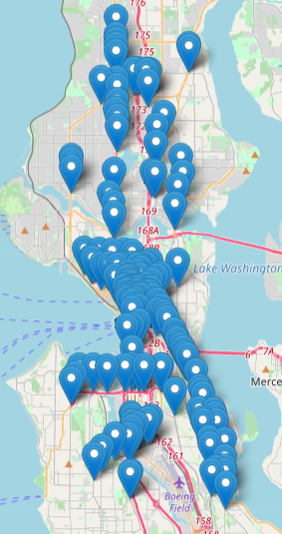
Accidents black-spot
The folium map located in Seattle shows the traffic black-spot using the density-based clustering method.
Each spotted locations represent a dense group of locations.
Dense group: more than 100 collisions happened within the 200 m radius.
Total 278 groups were found.
Black-spots can form another network if the constraints are relaxed.
Summary: Locations is a important factor of collisions
Special care should be made on those spots

Slide 13


Dangerous level prediction
Using similar concept of black-spot, dangerous level prediction algorithm was
developed.
Input: location coordinate
Output: number of collisions, dangerous level and most common type of collisions
Two different locations are input
The first one gave dangerous warning with 50(Struck fixed obejct). The second one show no collisions happened before nearby

Slide 14
Conclusion
The seriousness of collisions are independent of other factors
The number of collisions are dominated by few types.
Policy focusing on these types can be used to reduce collisions effectively
Traffic Black-spots are located
Updated road design should be considered in the future
Dangerous level prediction was developed
More feature can be implemented depend on the need
Using Google Map API, app can be developed for application

Slide 15
Special thanks to IBM and Coursera
End

